Slide 1
Introduction to data analytics
sudhanthiralakshmi m
7229-chennai

Slide 2
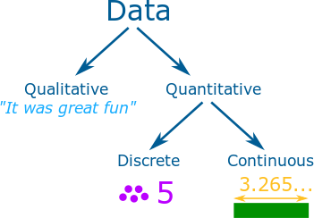
DATA - Facts and statistics collected together for reference or analysis ANALYTICS- The systematic computational analysis of data or statistics
Classification of data

Slide 3
PROBABILITY IN DATA ANALYTICS:
It is an important skill for data scientists using data affected by chance. With randomness existing everywhere, the use of probability theory allows for the analysis of chance events.
STATISTICS IN DATA ANALYTICS:
Statistical knowledge helps you use the proper methods to collect the data, employ the correct analyses, and effectively present the results.

Slide 4
TYPES OF DATA ANALYTICS:
Descriptive analytics - Descriptive analytics answers the question, “What happened?
Diagnostic Analytics - addresses the question, “Why did this happen?”
Predictive Analytics - answers the question, “What might happen in the future?”
Prescriptive Analytics - answers the question, “What should we do next?”

Slide 5
PROCESS INVOLVED IN DATA ANALYTICS
Identify business problems
Identify data sources
Select the data
Transform the data
Analyze the data
Deploy the Model and Implement
Clean the data

Slide 6
Thank you...

